Slide 1
Venture Capital in China’s Commercial Space Sector
Searching for Elon
Jacob Libby Rob Krawczyk

Slide 2
TABLE OF CONTENTS
01
02
03
04
Regulatory Foundation
Perspectives: Startup CEO
Perspectives: VC Investor
Perspectives: Government
How the Chinese government has fostered the space boom
Juggling drive for success and the state
Private vs Public;
Time horizons and exit strategies
Capital allocation and market challenges abroad

Slide 3
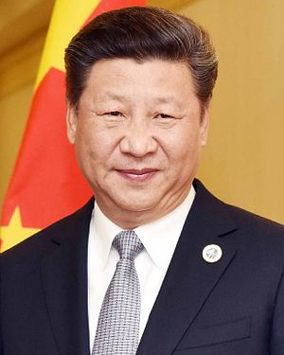
01
Regulatory Environment

Slide 4
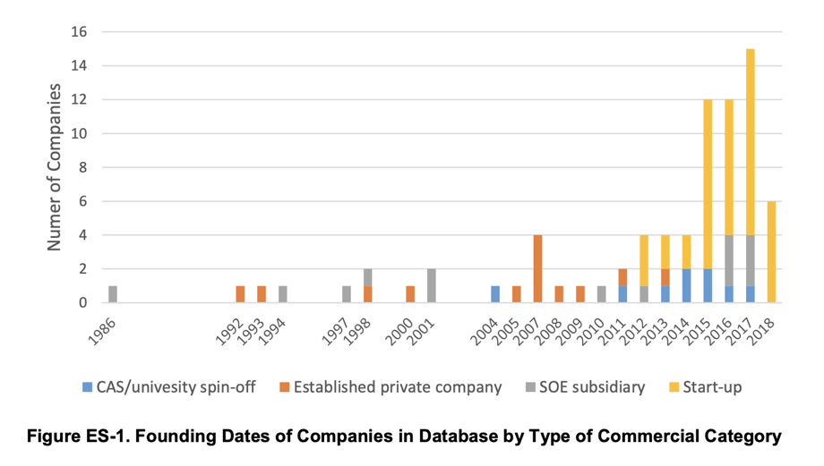
Document 60 and the Space Boom
Qian Xuesen, an early leader in rocketry, was repatriated during the Cold War by the US to China, where he became the father of their space-launch program
Fast forward to 2014, China’s State Council releases Document 60 to open the launch and and small satellite sectors to private capital
Did it have a real impact?
This has been followed by policies such as civil-military integration and patent sharing

Slide 5
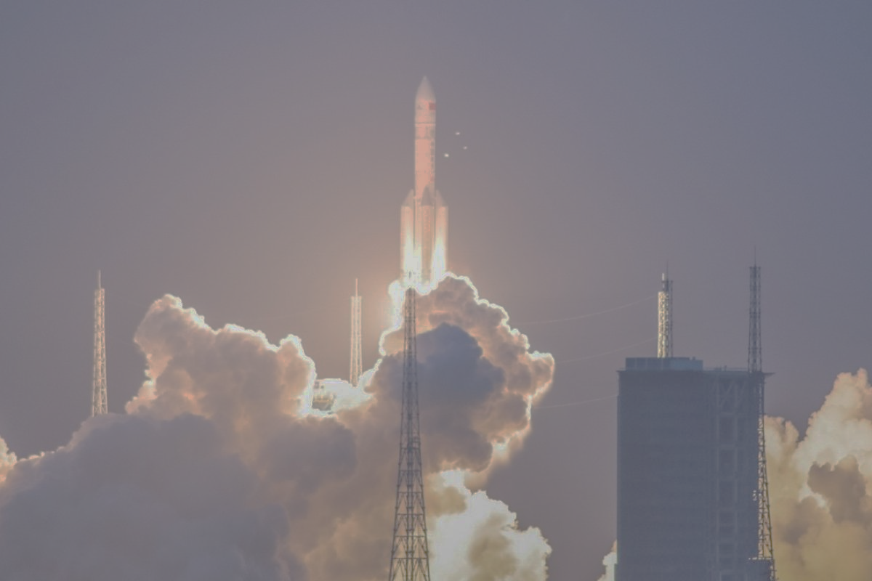
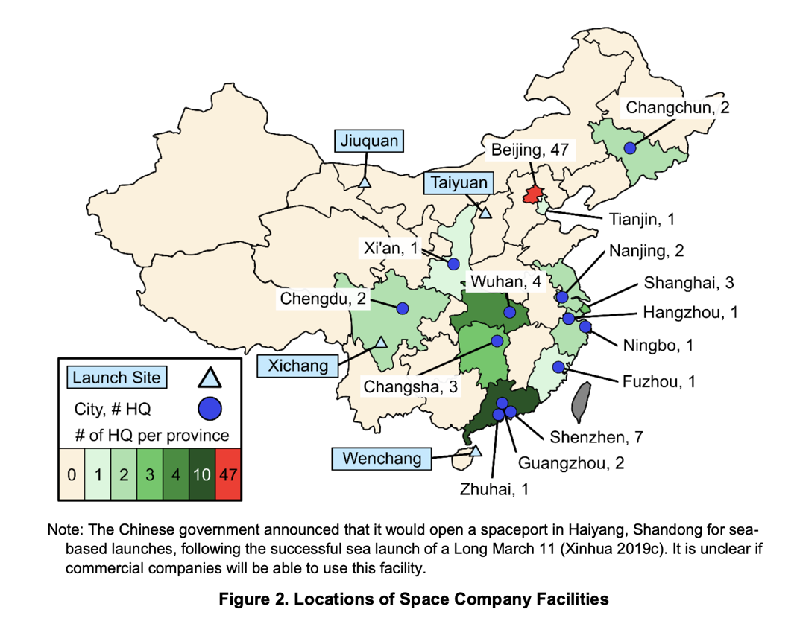
Who’s driving this and where?
Chinese leadership is swelling with aerospace expertise
Beijing and Guangdong are the epicenters

Slide 6
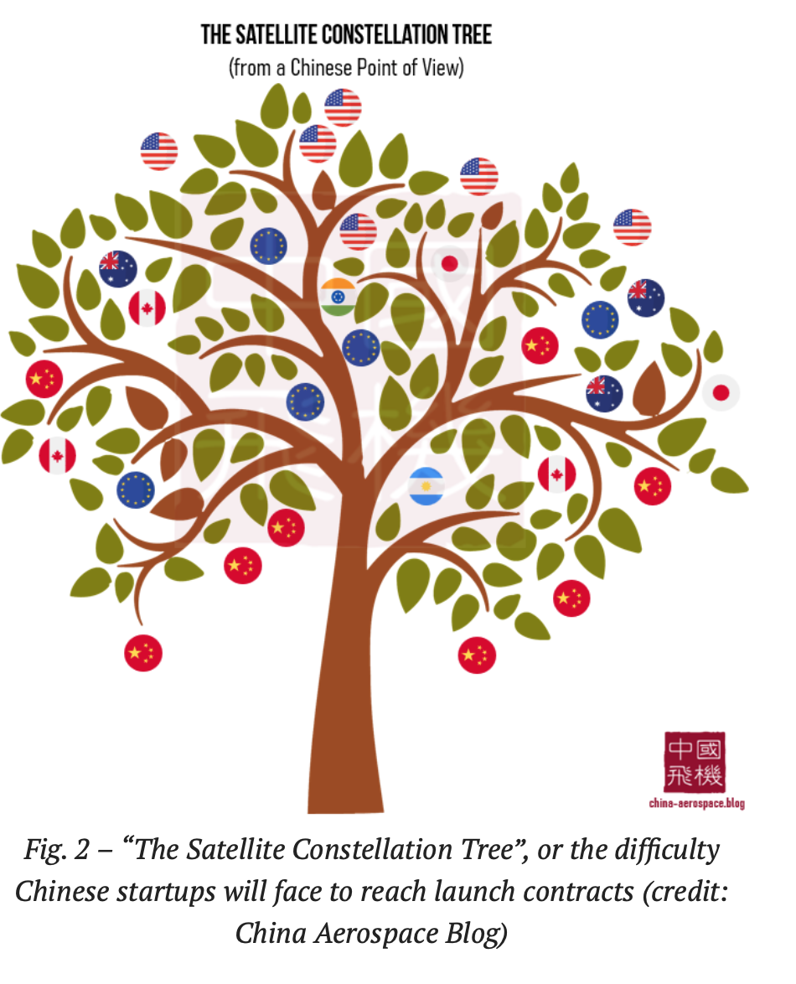
02
Perspectives: Startup CEO
Notes:
In general, these companies have existed since 2014 and have business plans similar to those of other New Space companies in the West. The largest of these companies have over $100 million in VC funding and several hundred employees; the smallest are still PowerPoint companies with little funding and few employees, but big goals.
The commercial space companies have focused on innovating on cost and leveraging second mover advantage by watching and learning from companies in the United States. Third, the companies benefit from the growing levels of private equity and VC funds in China, looking for investment opportunities outside the IT and telecommunications sectors. Lastly, U.S. and other countries’ export control regimes are viewed as, and could well be, an initial challenge that ultimately results in a positive outcome by forcing the development of indigenous supply chains as well as domestic markets.
Many founders of Chinese space companies spent their careers developing technologies at SOEs, CAS institutes, and universities. Starting their own companies gave them a chance to commercialize their technologies and technical knowledge. For example:
Prior to founding MinoSpace and LandSpace, Wu Shufan had been an aerospace professor at several universities in China and Europe and a researcher at the European Space Agency.
Prior to becoming the chairman of LandSpace, Wang Jian Meng (王建蒙) worked at Xichang launch center, the Beijing Launch and Control Center, then as Executive Vice President of APT Mobile Satcom Limited, a geosynchronous Earth orbit (GEO) communications satellite company.
Peng Xiaobo, founder of iSpace, was the director of CALT’s R&D center (Jilin University Zhuhai College 2016). He was also the head of CASC’s First Academy R&D department.
Some company founders, like OneSpace founder Shu Chang, worked in the CASC space investment fund (航天科技集团航天产业基) and as a vice president in strategic investment at Legend Capital (联想控股投资) prior to starting a space company. Following the 2014 policy change, Chang decided to found OneSpace after being unable to identify any space companies he thought would be strong investments (Goh 2018).

Slide 7
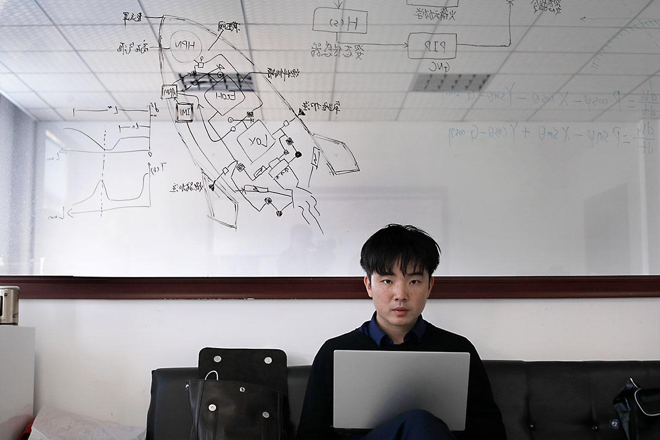
1. Find Financing
Attract VC funding as investments cycle out of IT and telecommunications into new sectors.
Hesitant Banks
Keen Provincial Government VC
Wuhan National Space Industry Base
Beijing E-Town (Municipal VC)
“Guidance funds” (CASC-Banks) as Testbed
Retain engineering talent from the spin-off/spin-in system of Civil-Military Integration 军民融合
REUTERS/Ryan Woo
Notes:
August 2020, iSpace Series B Funding and Landspace Series B funding jointly led by Sequoia Capital China, Country Garden Venture Capital, Matrix Partners China and Cornerstone Capital. Additional investment came from the National SME Development Fund and others.
Keen provincial government VC
While central government pronouncements “signal” government interest and guidance, most government investment and support for commercial space companies has come from provincial and local governments.
Xi’an, Wuhan, Hubei “boost aerospace industries” (Myrrhe 2018). Some municipalities have worked to build space industry clusters, such as Jilin, which helped develop the Changguang Aerospace Information Industry Park (长光航天信息产业园). This industrial park is planned to have an annual capacity of 30 satellites and 200 drones, and will gradually form an industrial cluster that will develop and produce satellite and unmanned aerial vehicles (UAVs) for remote sensing information processing and applications. Other cities with aerospace strategies include Chongqing, Shenzhen, and Changsha.
Guidance Funds
China Aerospace Science and Technology Corporation - CASC, along with several Chinese banks, established the 150 billion RMB (approximately $22 billion) Guochuang Investment Guidance Fund (国创投资引导基金, short for “national innovation fund”) to foster developing industries, support civil-military integration, and help SOEs to become more innovative (Chen 2017). Like other funds established by SOEs, this fund targets SOE subsidiaries.
Spin-off-spin-in
Spin-offs have been found to be better at diffusing ideas than transfers of intellectual property (IP). We identified the following reasons why SOEs have been amenable to sharing or transferring technologies:
To access open and shared space launch sites and aerospace measurement and control systems
To share support infrastructure such as testing facilities
To assist in the construction of research clusters
To increase competition among suppliers and system integrators to reduce prices
To promote the transfer of military dual-use technologies to civilian industries
To actively guide the development of satellites and application industries to promote application service innovations and scale applications
It is expected that spin-in commercial developments would be streamlined with policies such as CMI, which has encouraged both the spin-off of dual-use technologies and excess military goods production capacity to civilian markets (军转民), and the spin-in of technologies developed by the commercial sector and the increased participation of commercial enterprise in defense development and production (民参军) (Laskai 2019). It is expected that spin-in commercial developments would be streamlined with policies such as CMI, which has encouraged both the spin-off of dual-use technologies and excess military goods production capacity to civilian markets (军转民), and the spin-in of technologies developed by the commercial sector and the increased participation of commercial enterprise in defense development and production (民参军) (Laskai 2019).

Slide 8
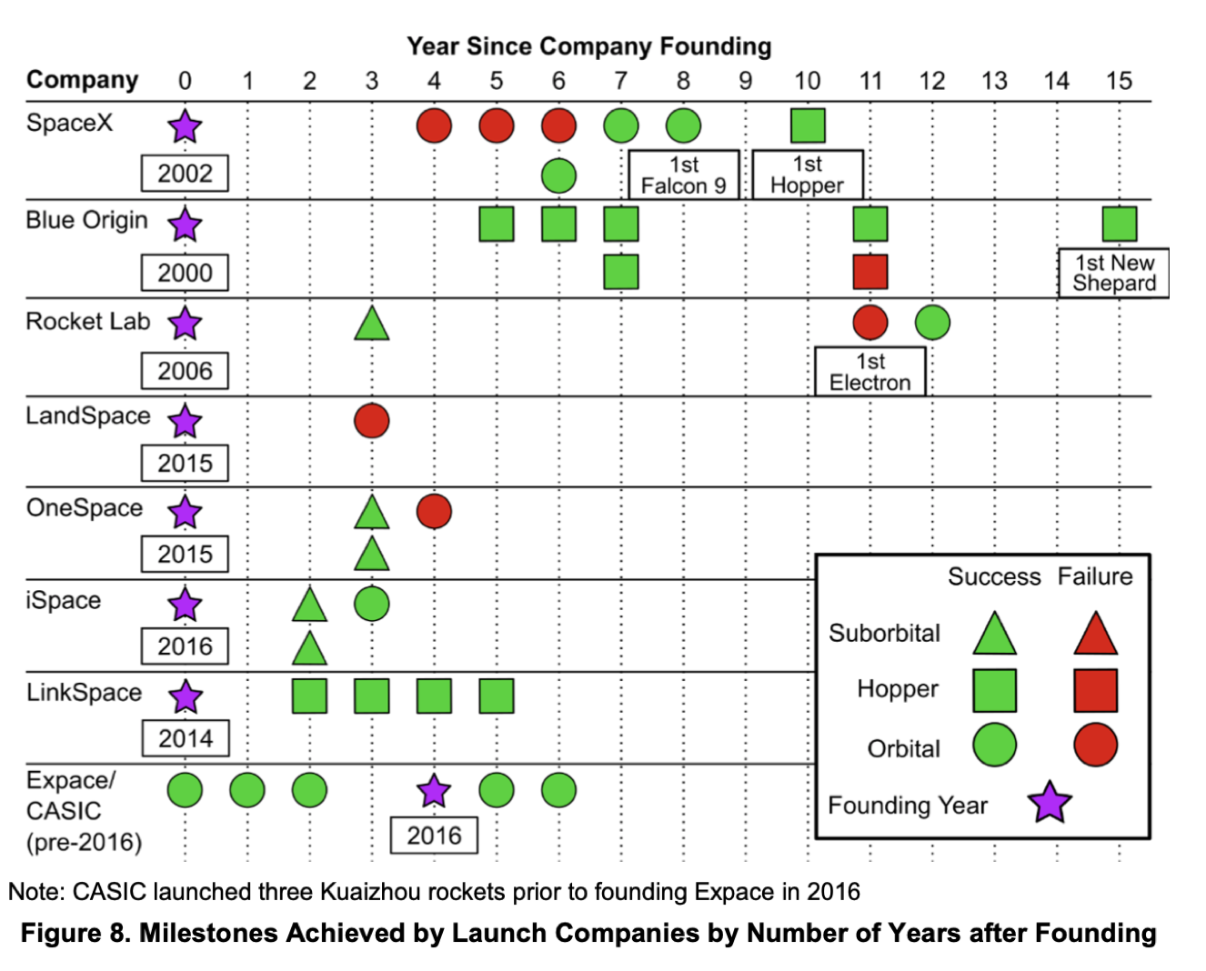
2. Eyes on the U.S.
Utilise government contacts (CASC, CAS, CASIC) for SASTIND Launch Licenses
Launch successfully, finance around success (second mover advantage on Space X) - signalling effect of frequent funding, testing
Seek Foreign VC Funding (longer investment horizons 8+7 than Chinese VC 3+2 plus expertise in foreign market)
Find a profit model (customers - domestic satellite industry, Belt and Road, iSpace 2019: CASIC payload)
Build resilience to ‘winters of capital’ (COVID-19?)
Notes:
‘I think Chinese companies are at right now is where Space X were around 2010. They still need a good five to seven years to catch up...But one advantage they have is they know what mistakes not to make after Space X made them.
According to Wu Shufan, the founder of satellite-manufacturing start-up MinoSpace “Chinese economic growth has been so fast and in the past two years space has gotten into what we call the ‘wind window’. ... And if you are in the wind window, even a pig can fly” (de Selding 2019).
Are companies announcing funding rounds on a 6 month to 1-year timeline or updating their investors in their government records frequently? Companies discussed that their funding rounds were shorter than that of American companies, meaning that more frequent rounds of funding would indicate they are meeting milestones set by investors.
Chinese VC firms are funding commercial space companies because they see Western VC firms investing in this sector. An employee of one company whom STPI interviewed stated that “VC funders in China are all relatively young. They don’t have the experience or wisdom to figure out what to fund so a lot are looking to the U.S. to see what [Western] VCs are funding in the U.S. and then they fund similar projects in China. For commercial space, Chinese VCs see that companies like SpaceX has received a lot of VC funding and they feel comfortable with investing in similar things in China.”
Throughout research for this report, STPI observed a notable change in community views of VC. In September 2018, at a commercial space conference in Wuhan, many presenters mentioned “winter of capital,” referring to the inability of many space companies to attract VC, in an apparent sharp departure from preceding years. In interviews conducted in March 2019, when asked about this trend, company representatives stated that during the first half of 2018, VC firms had been hesitant to invest, but since that time companies with strong business plans have been able to attract VC. Chinese venture capitalists and reports on VC in China have noted that funding has begun to concentrate around a few categories such as launch (Future Aerospace Research Institute 2019a; Zhou 2018). This suggests that although VC may have initially saturated the market when private investment in space was first allowed, VC firms have since become more cautious when investing in space companies, and are conducting more due diligence on companies’ market prospects.

Slide 9
03
Perspectives: VC Investor

Slide 10
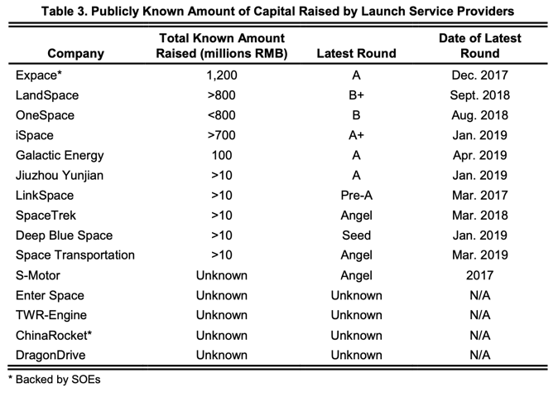
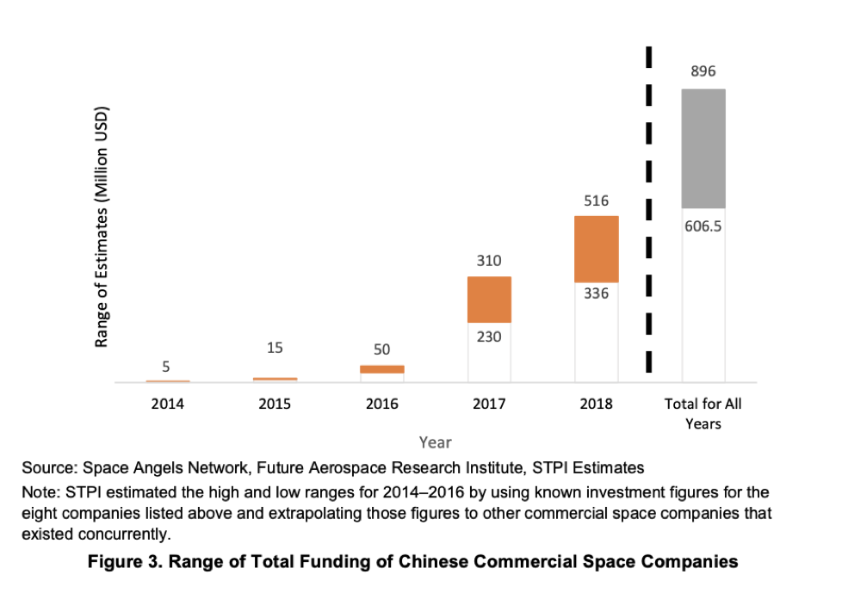
A Flurry of Capital

Slide 11
VC Challenges
High State Involvement
Frequent Launch Failures
Potential for Overcapacity
Uncertain Exits
Risk of poor allocation of capital
Need to prove a higher rate of success
Too many startups for all to get a good payout?
Detrimental time horizons and lack of examples

Slide 12
“China is not lacking in capital to invest in the space sector, there is plenty of money out there ready to pour in… But for a lot of investors, space startups need to prove their worth first.”
—Wayne Shiong, China Growth Capital

Slide 13
04
Perspectives: Government

Slide 14
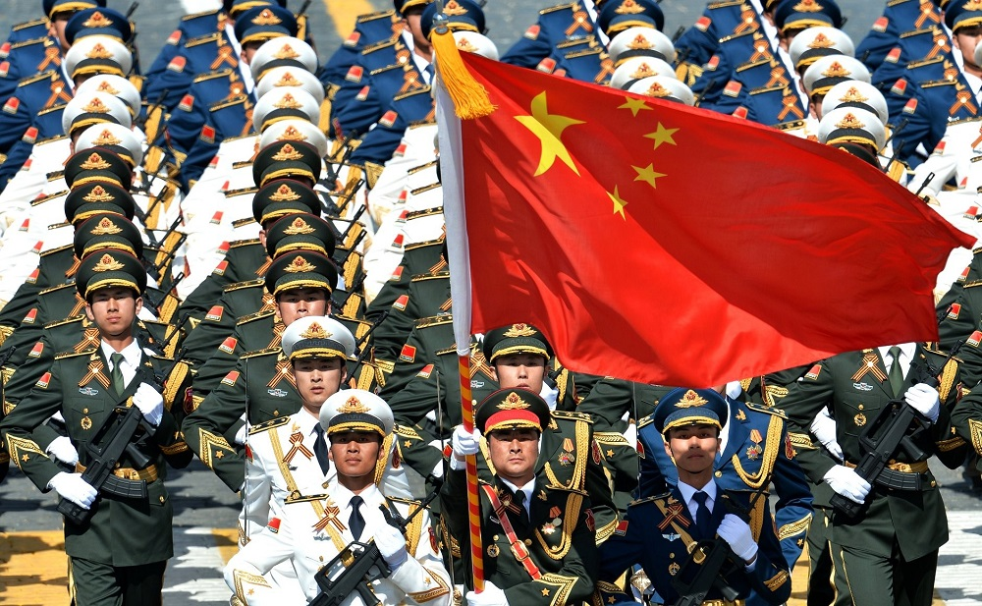
Steadying the Guiding Hand
If identifying future “national champions” ensure best allocation of capital possible
Keep provincial and local government VC funds disciplined
Learn from solar panel market experience
Learn from BeiDou - 20 years, $10 billion
Broaden transparency and fend off export-import and investment restrictions (CFIUS) over military ties
Could export controls be turned to advantage driving indigenous supply chains?
Notes:
Currently, the United States restricts exports of space technologies to China and forbids U.S. companies from using Chinese launch vehicles. In recent years, other spacefaring countries and companies have also become wary of China because of the likelihood that their technologies may be stolen. As a preventive measure, some foreig
The decoupling can be seen in data showing that Chinese venture-capital investment in the United States dropped to a six-year low in the first half of 2020, to $800 million, according to research provider Rhodium Group. VC investment by U.S. firms in China hit its lowest level in four years, at $1.3 billion
Michael Borrus, the founding general partner of XSeed Capital, said CFIUS scrutiny is causing investors and companies to think twice about deals. “We’ve had Chinese VCs or Chinese families who have been interested in putting money in” to some companies where XSeed Capital is a shareholder, Borrus said. “In the current environment, we’ve decided it’s too complicated.”
https://www.washingtonpost.com/technology/2020/09/29/cfius-review-past-chinese-investment/
The 2016 White Paper is also the first space white paper to acknowledge private investment and private companies in the space industry. This White Paper calls for increased cooperation between the government and private investors in the space industry, and encourages social capital, which usually consists of nongovernmental and private capital, to participate in space-related activities, including scientific research and production, space infrastructure, and space information products and services. Notably, the White Paper includes a section on “diverse funding” (Section 6 of Chapter 4), which includes several references to increasing commercialization of space through private funding. Notably, the White Paper includes a section on “diverse funding” (Section 6 of Chapter 4), which includes several references to increasing commercialization of space through private funding.
“BeiDou is the perfect example of what China’s space industry has been like over the past decades: state-led, with world-leading technologies, but not evolving as quickly or spending as efficiently as it should be,” said Wayne Shiong, partner at venture capital firm China Growth Fund, which is a backer of Chinese rocket start-up LandSpace.

Slide 15
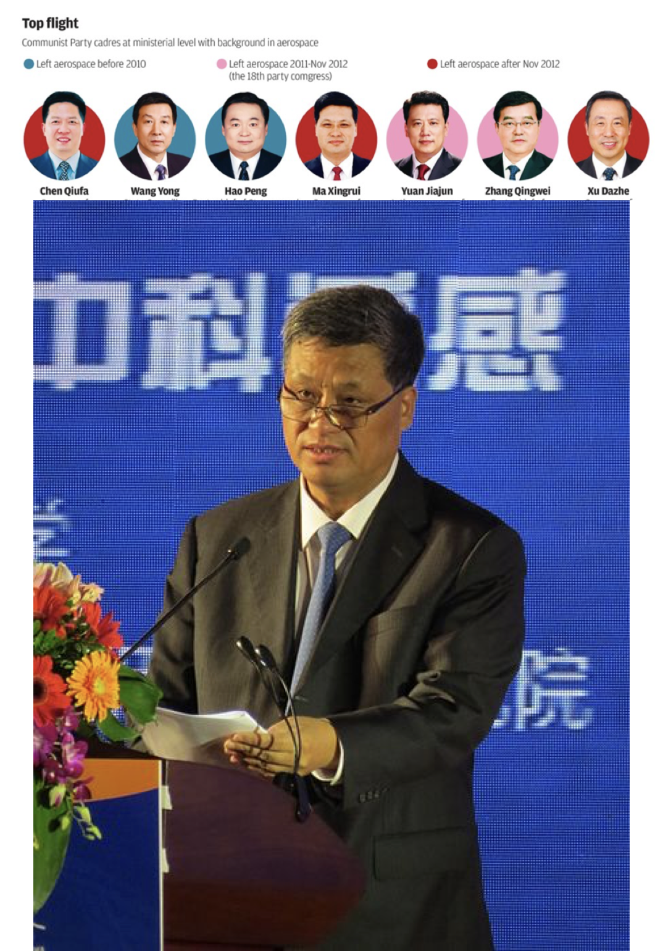
Steadying the Guiding Hand
Backchannel with leading entrepreneurs to maintain positive rapport and avoid regulatory debacles
How would an Elon Musk personality fare in Beijing?
Is there a mismatch between young space entrepreneurs and older government regulators?
Young entrepreneurs solution to brand image problem abroad?
Shu Chang, OneSpace Founder
Ma Xingrui Governor of Guangdong, Director of the China National Space Administration
Notes:
“Until the Chinese government can hand out contracts to private space companies like Nasa does, all the announced government support policies are just talk,” Mr Li said.
Shu Chang, worked in the CASC space investment fund (航天科技集团航天产业基) and as a vice president in strategic investment at Legend Capital (联想控股投资) prior to starting a space company. Following the 2014 policy change, Chang decided to found OneSpace after being unable to identify any space companies he thought would be strong investments (Goh 2018).
Several companies noted that one strength of China’s space sector is that its workforce is relatively young compared to its Western counterparts. One subject matter expert observed that at international space conferences or business meetings, the average age of the Americans appears to be 50 or older, while those from China are in their 30s. The consensus among our interviewees was that because commercial space is such a nascent sector, it needs young, innovative thinkers who are willing to work long hours and embrace the start-up culture. One employee of a state-backed company with whom we spoke stated that his company hires young talent as part of its strategy because (he felt) older generations may not be as suited to thinking creatively as those who are younger.
Interviewees also noted that many Chinese space companies (and China at large) had a 9-9-6 work culture where employees work long work days (9-9-6 refers to a work that goes from 9 am to 9 pm, 6 days a week). Some in China believe that working these long hours makes China’s commercial space sector more productive, although one could argue employees in the United States work just as hard or even harder. Such a work culture may also lead to employees burning out or quitting.

Slide 16
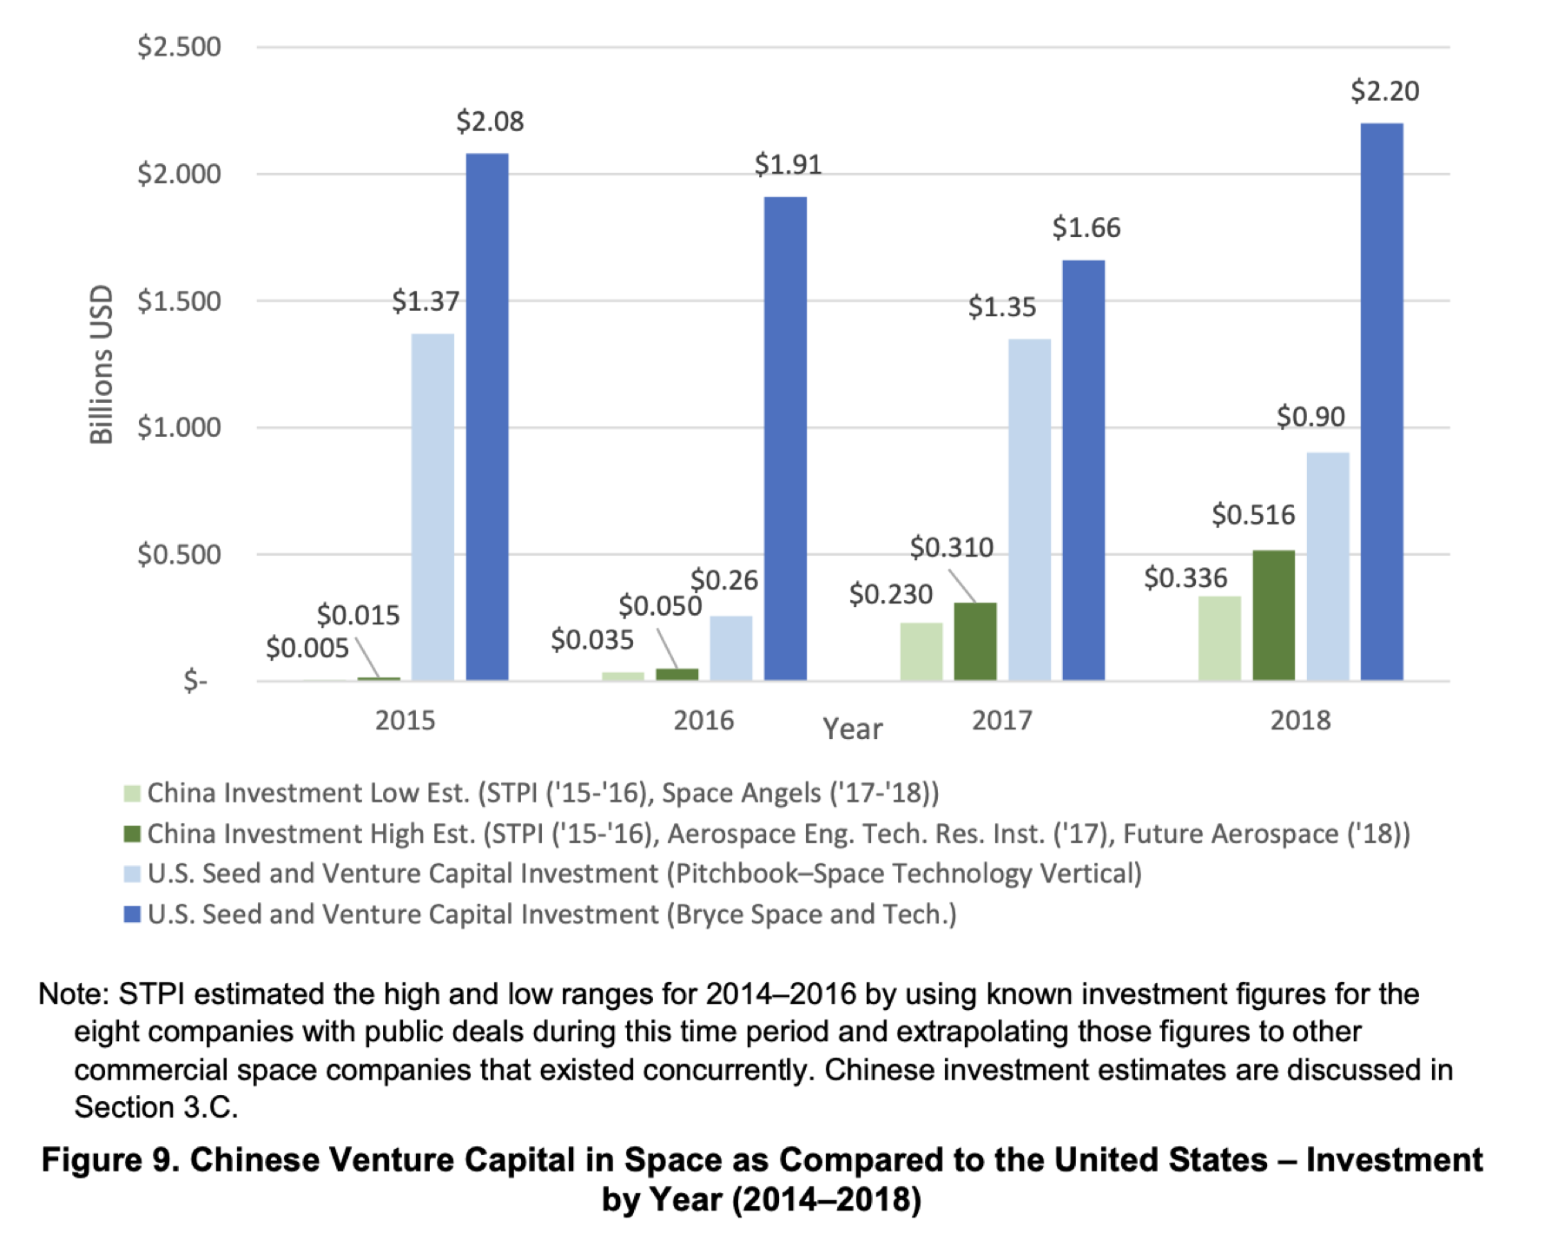
Steadying the Guiding Hand
The ‘simultaneity problem’ of replicating the American venture capital market.
Japan and India competitor space startup ecosystems growing.
Notes:
While VC investment in Chinese commercial space companies is growing, VC levels in China could be up to two orders of magnitude lower as compared with VC investment in the United States (Figure 9).
Deep pocket = shallow capital markets in China, need to attract more overseas investment… onshore / offshore bond issuances
How to attract foreign VC capital in perception of civil-military integration
Replicating the American experience in the creation of a venture capital market brings up the “simultaneity problem” as coined by Professor Ronald Gilson – three central inputs must be simultaneously available: (1) entrepreneurs, (2) providers of capital with the appetite for high-risk, high-return investments, and (3) specialized financial intermediaries which serve as the nexus of a set of sophisticated contracts.
Japan and India competitor space startup ecosystems growing.
Earth-Moon Space Economic Zone 2050
Deep Earth, Deep Sea, Deep Space - Deep Pocket - too many directions at once?

Slide 17
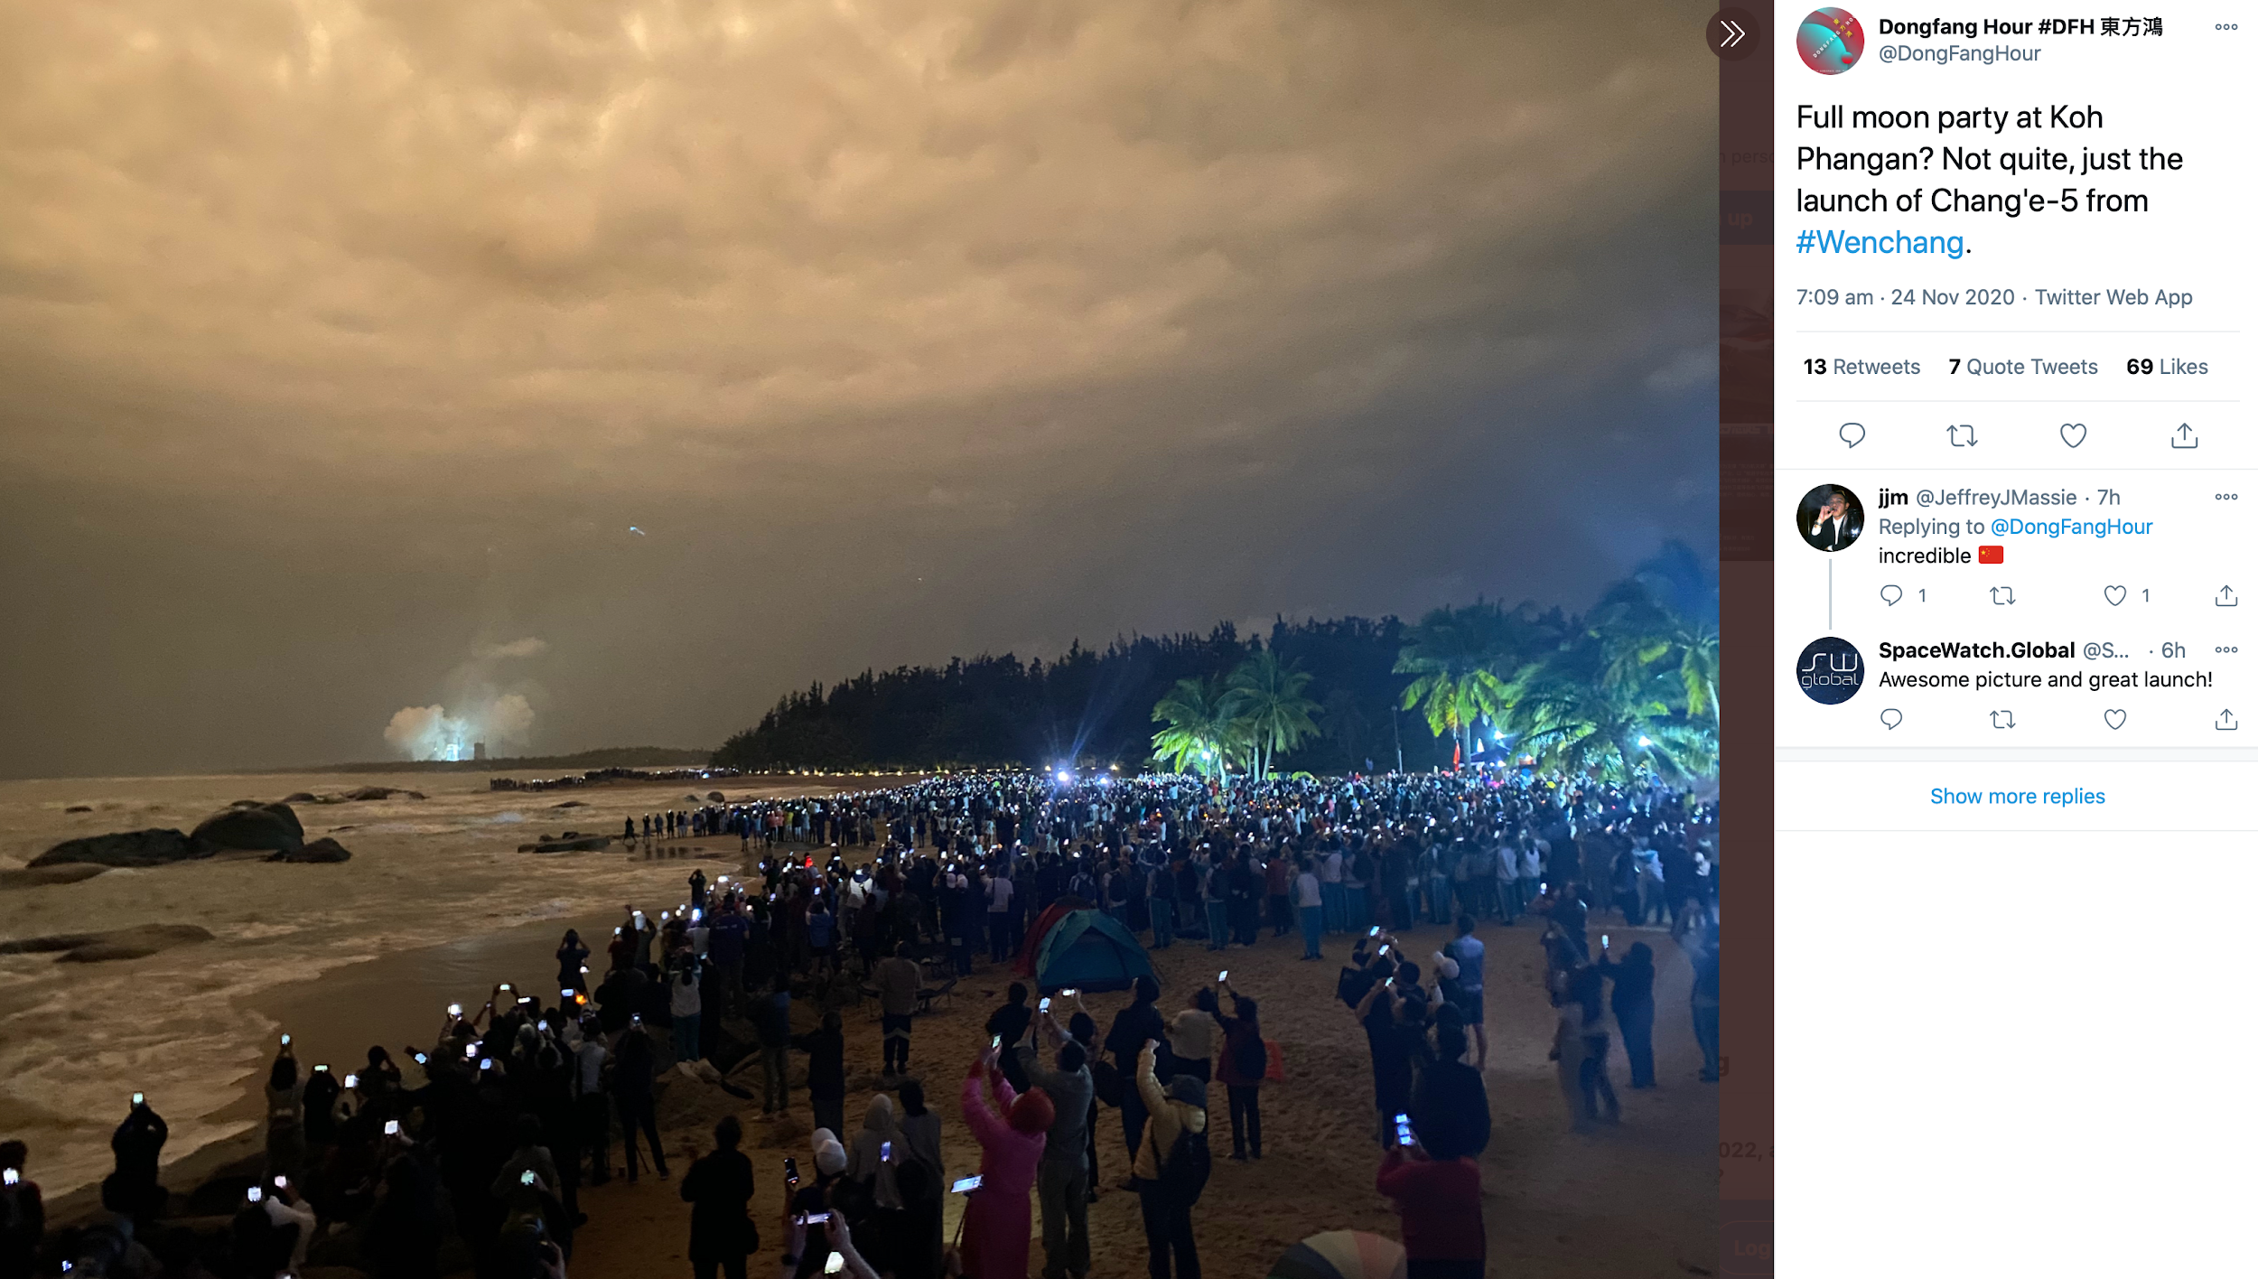
Q&A

